Slide 1
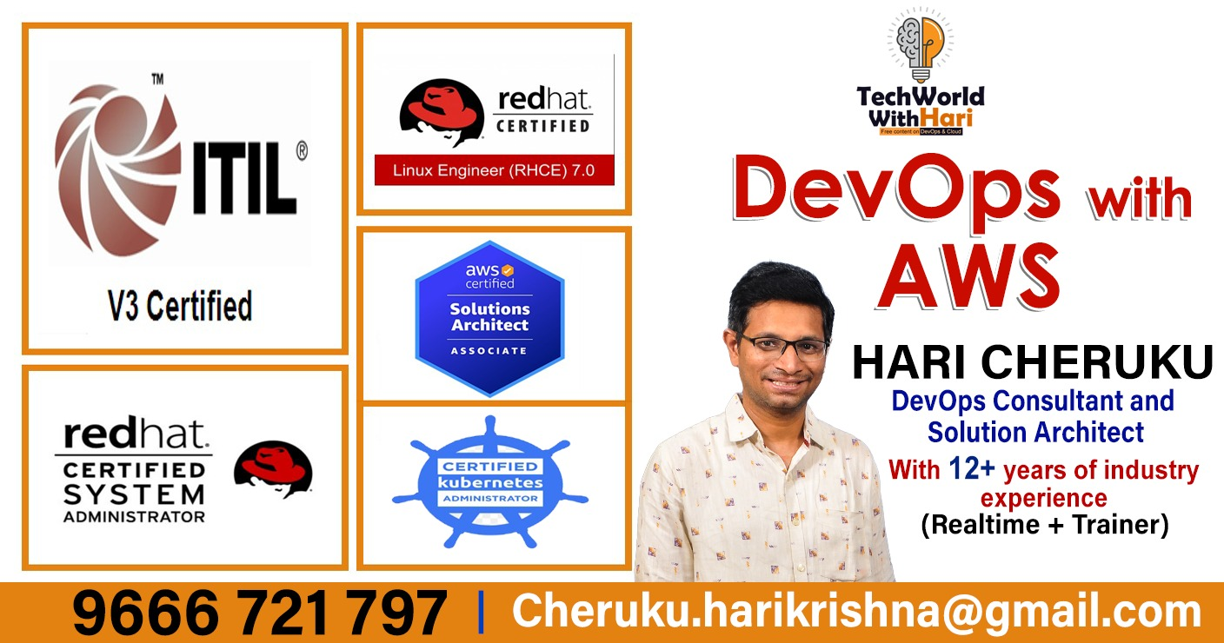



Slide 2
Welcome!
It’s our first meetup, You’re all welcome !
This Workshop is for Linux and AWS cloud
Our future plans to give more workshops on all the DevOps modules also like, Git(Github,Bitbucket &GitLab), Jenkis(CI/CD),Terraform(IAC tool), Ansible,Docker, Kubernetes(k8’s)

Slide 3
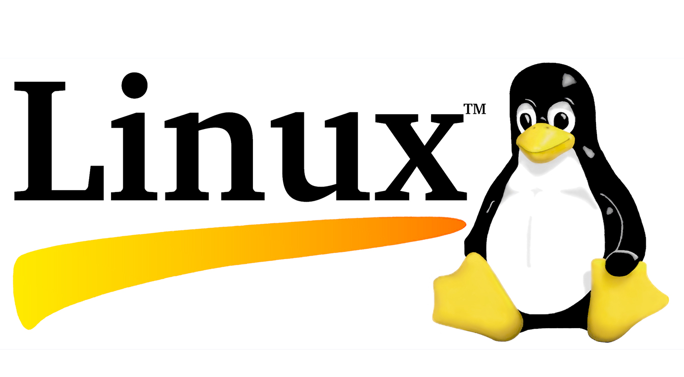

WORKSHOP Linux and AWS Cloud

Slide 4
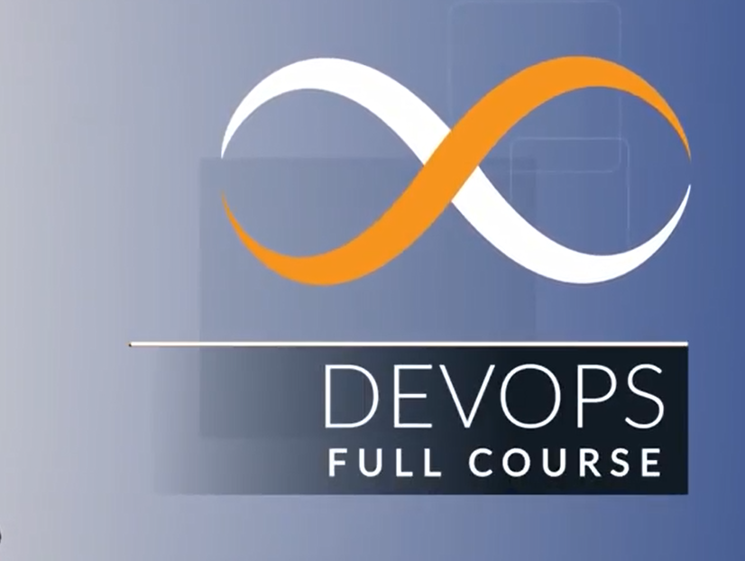

Slide 5
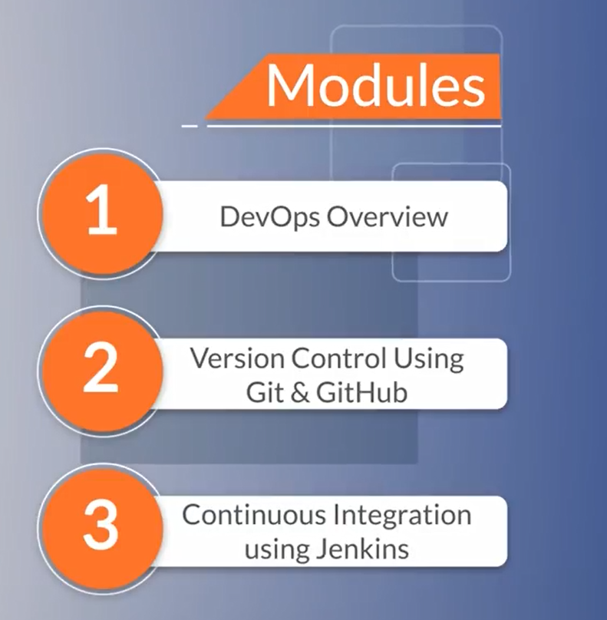

Slide 6
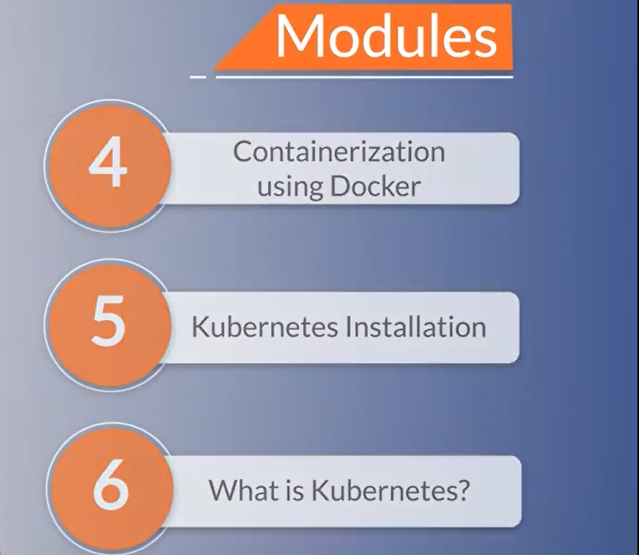

Slide 7
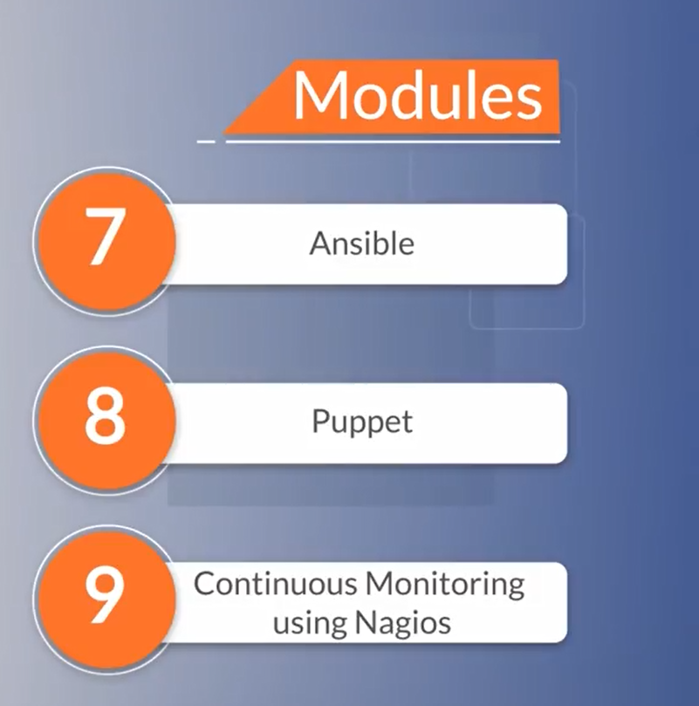

Slide 8
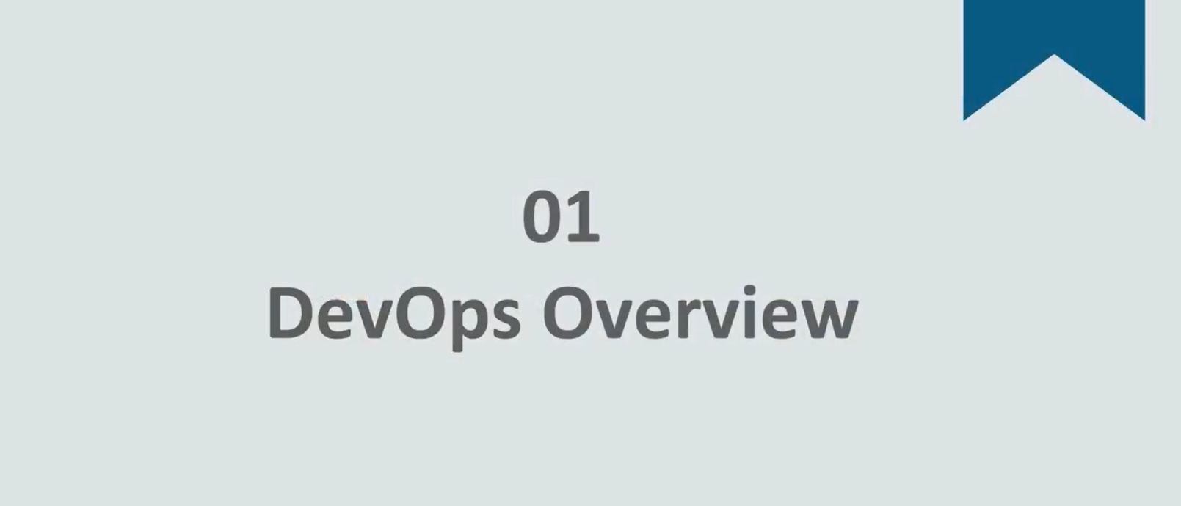

Slide 9
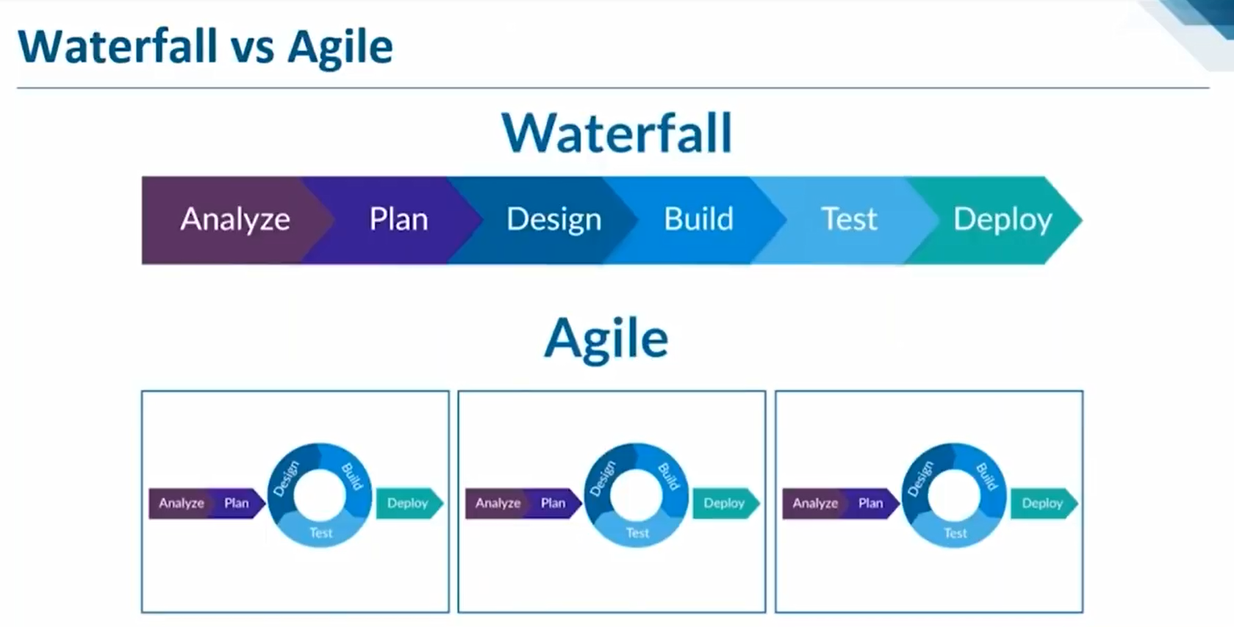







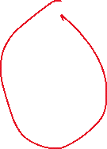


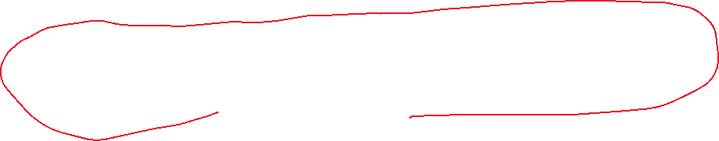




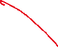










Slide 10
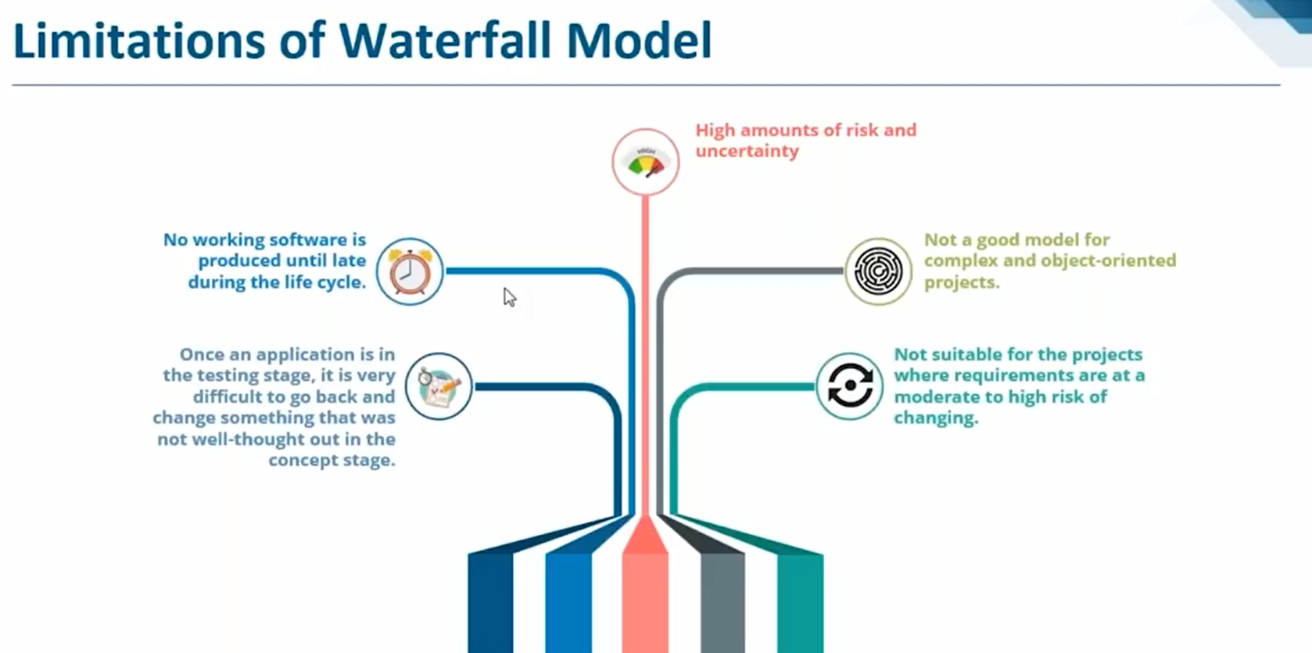

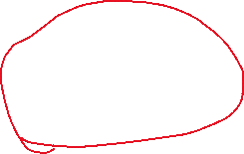


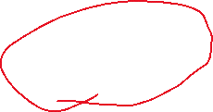

Slide 11
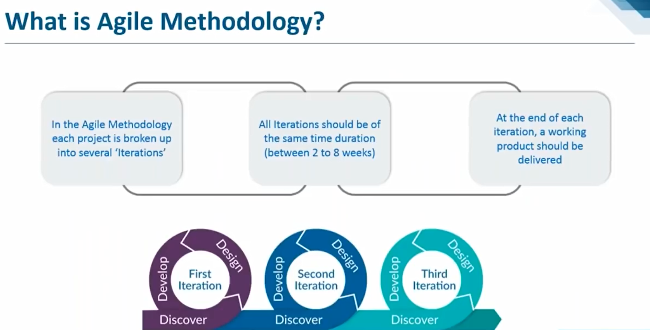












Slide 12
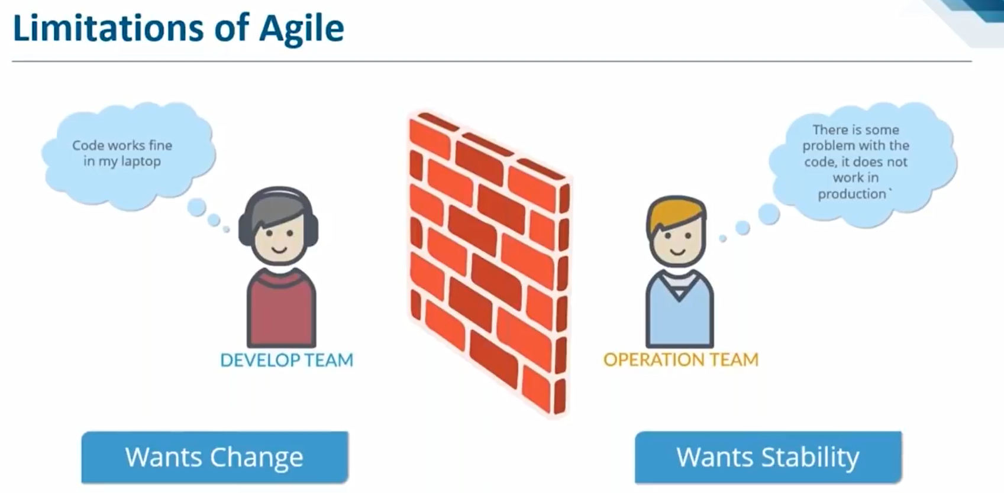







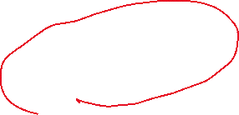







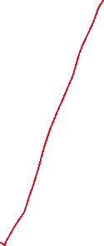










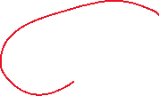





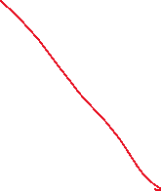


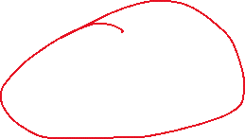

Slide 13
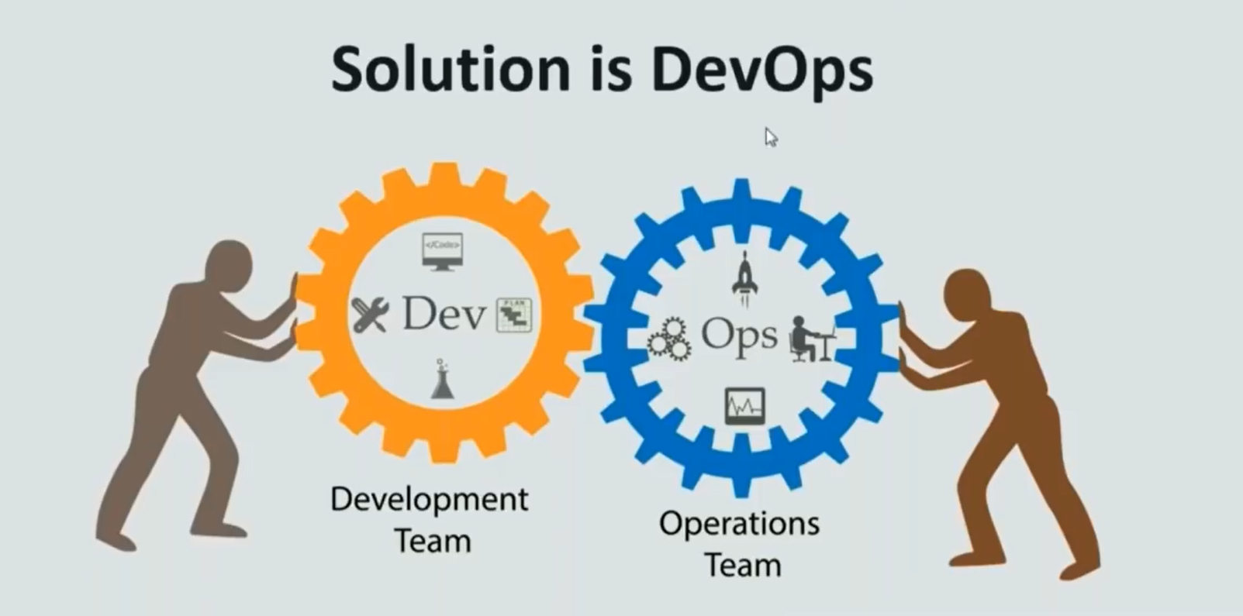











Slide 14
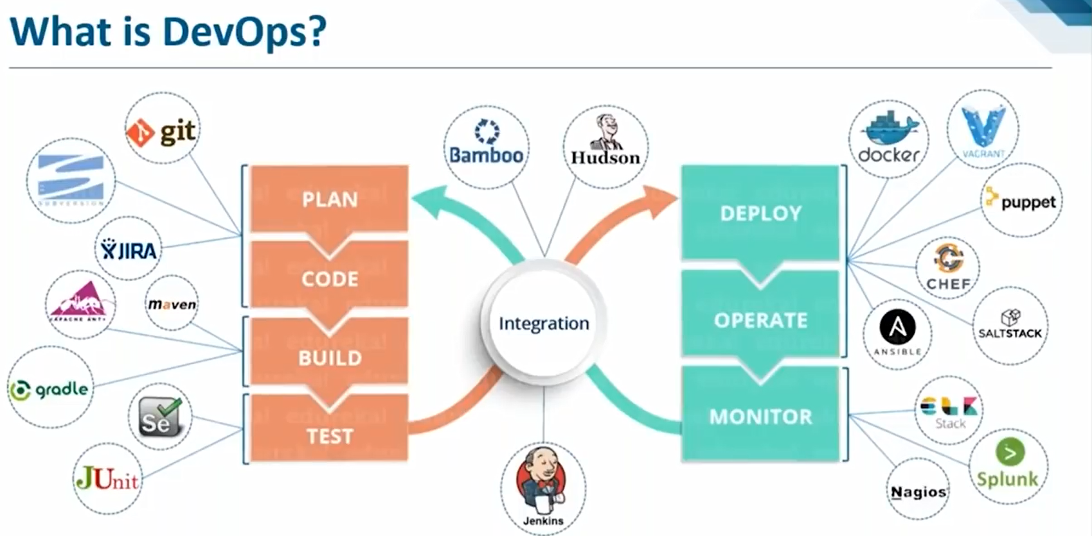













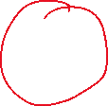




































Slide 15
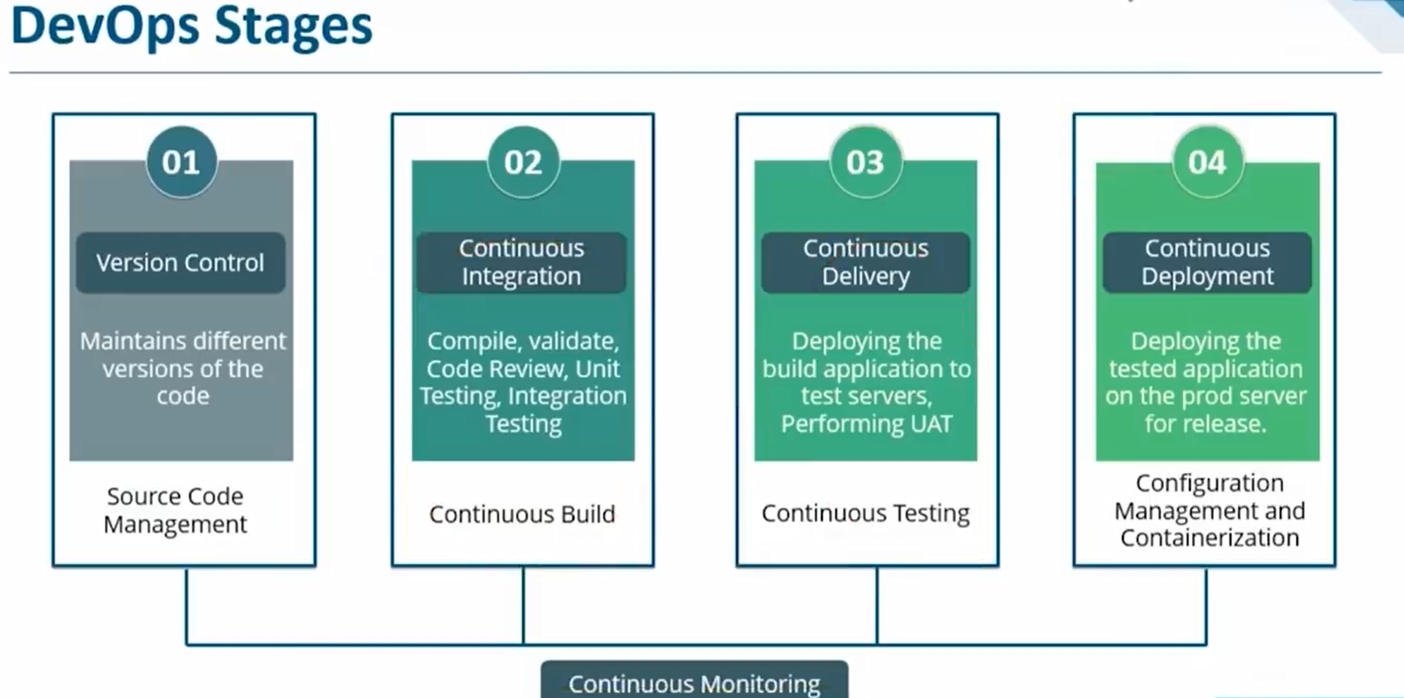
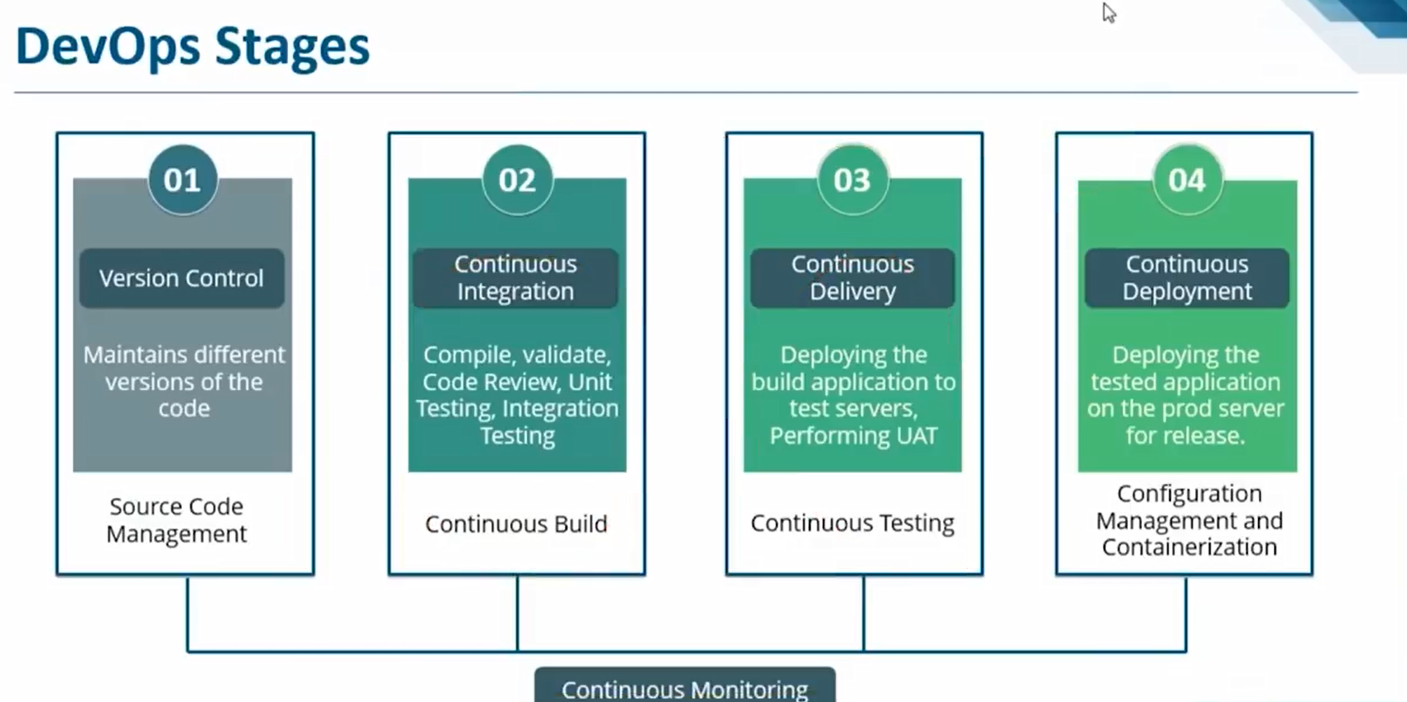

Slide 16
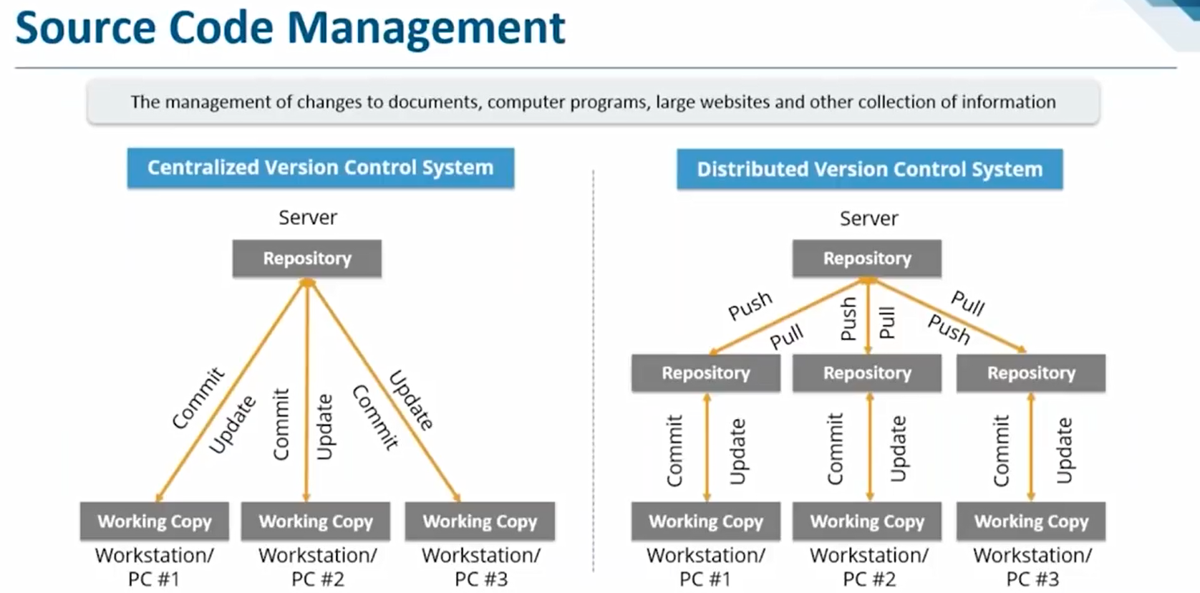

Slide 17
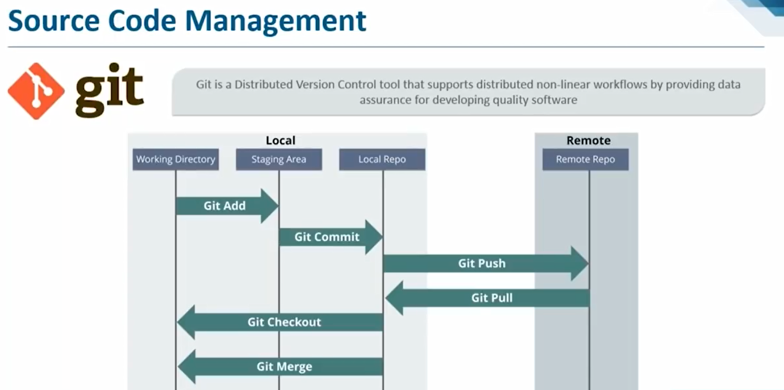
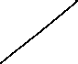
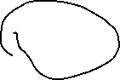
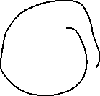


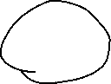


Slide 18
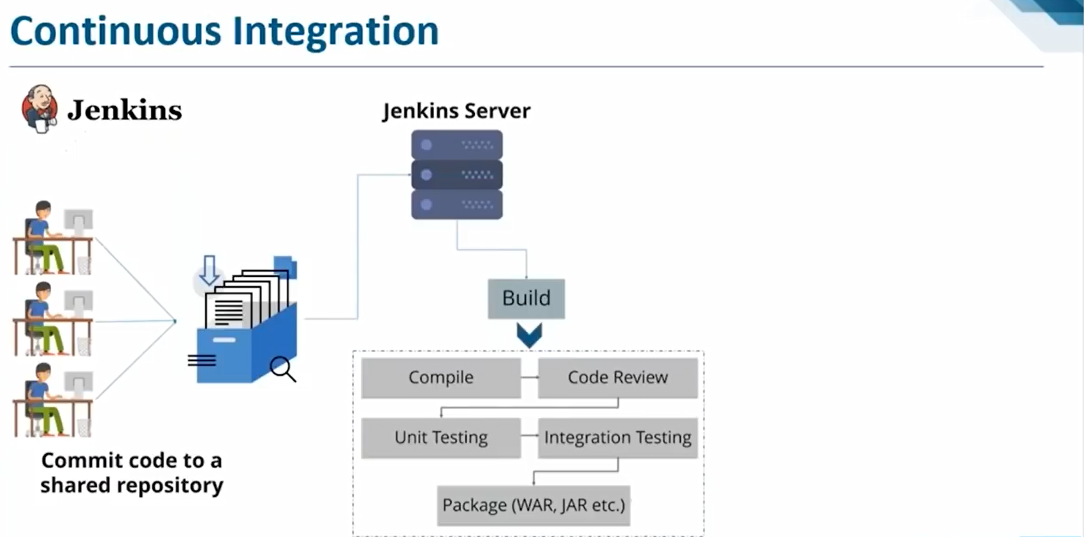







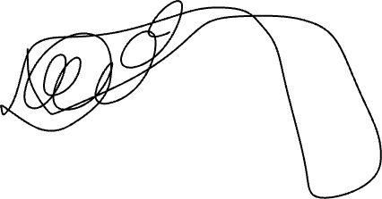

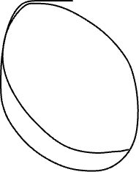
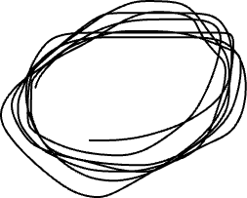

Slide 19
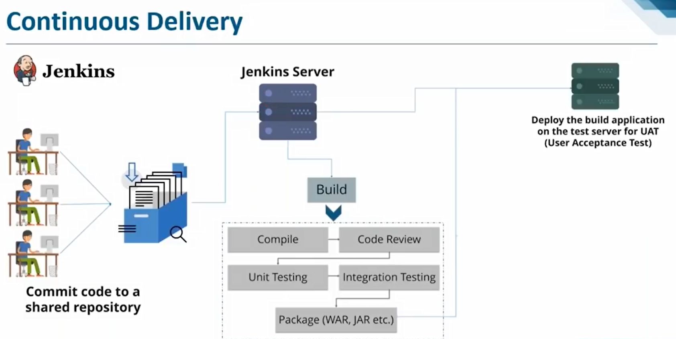

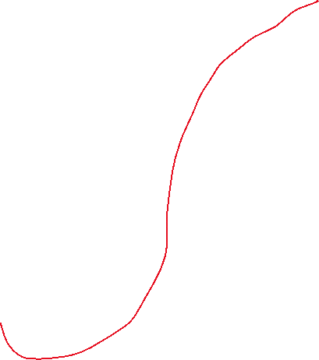



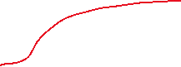

Slide 20
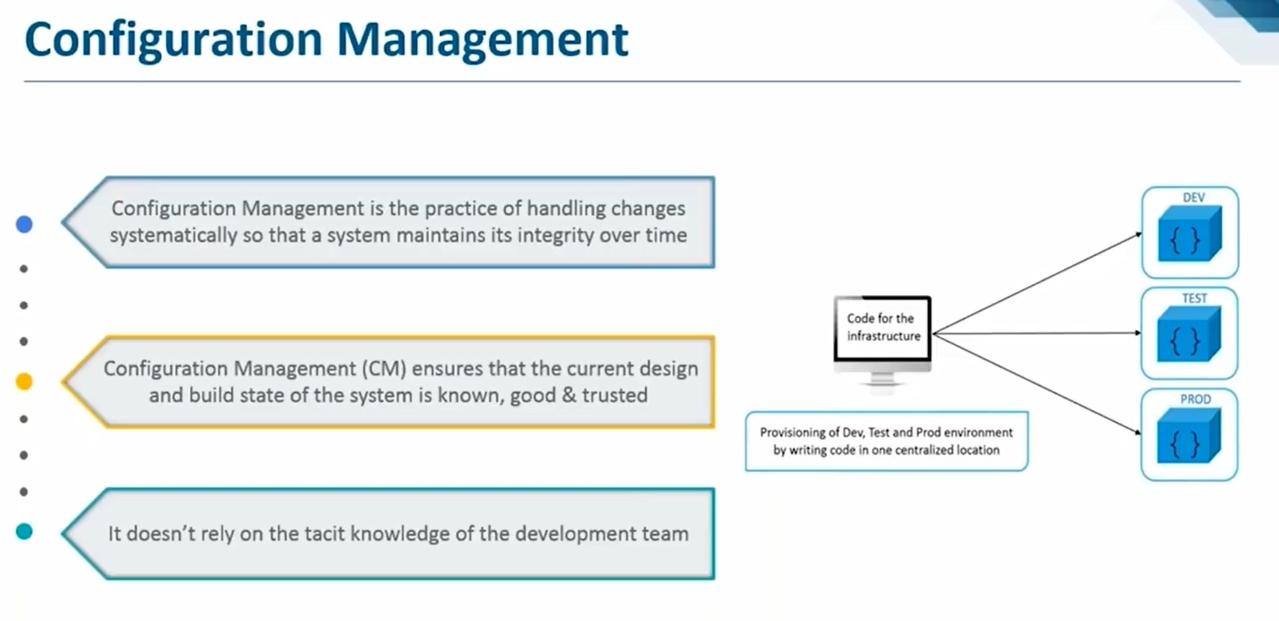

Slide 21
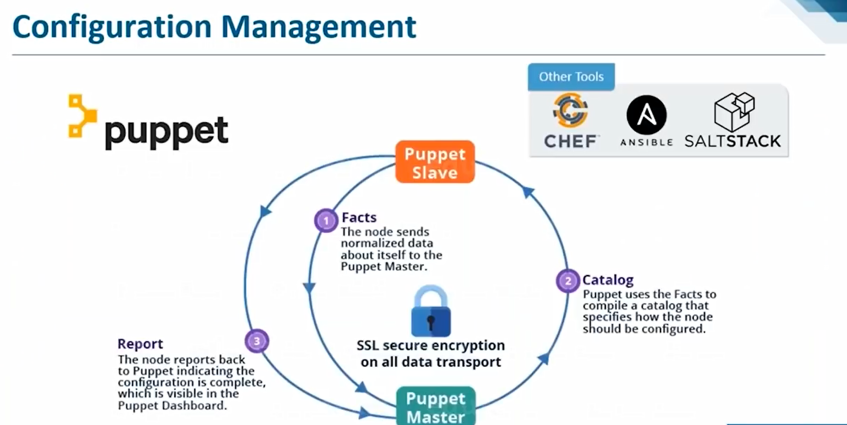

Slide 22
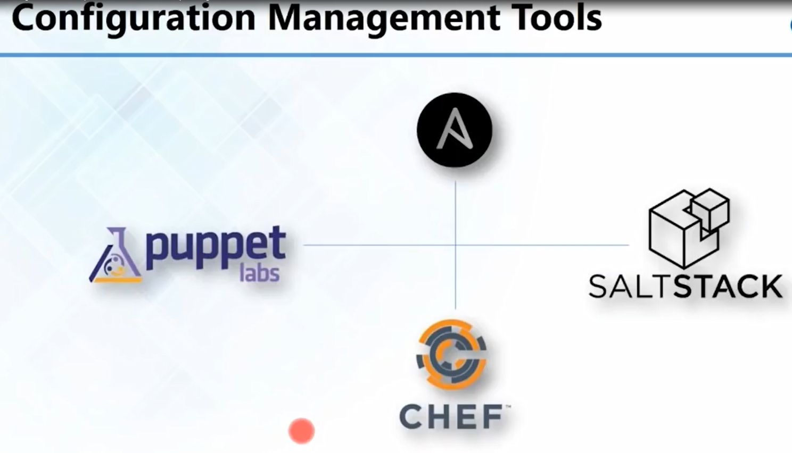

Slide 23
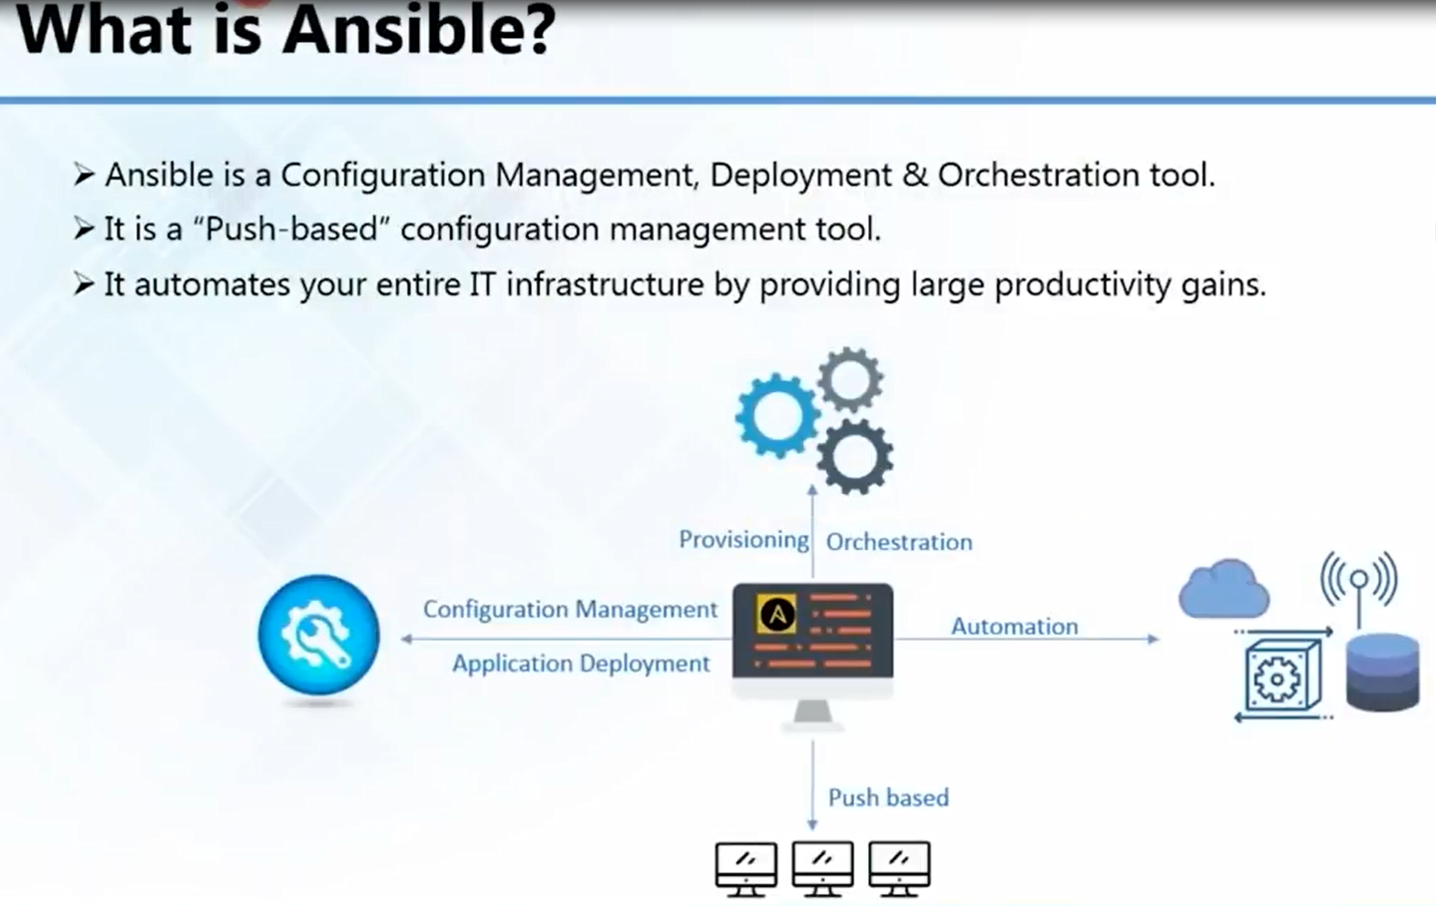

Slide 24
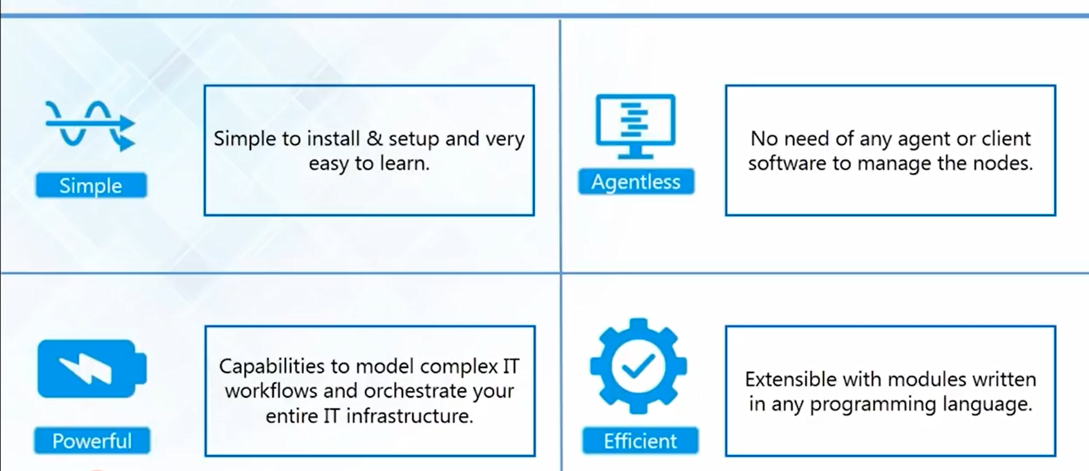
Features of Ansible

Slide 25
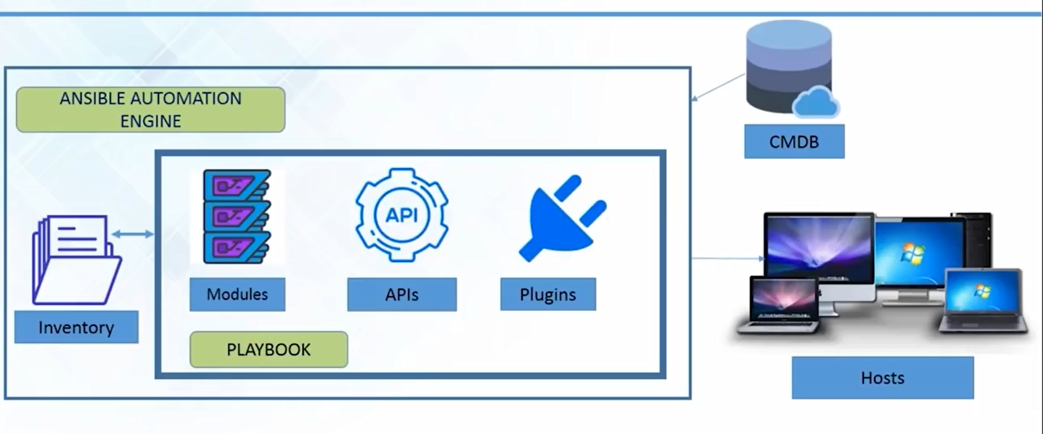

Ansible Architecture

Slide 26
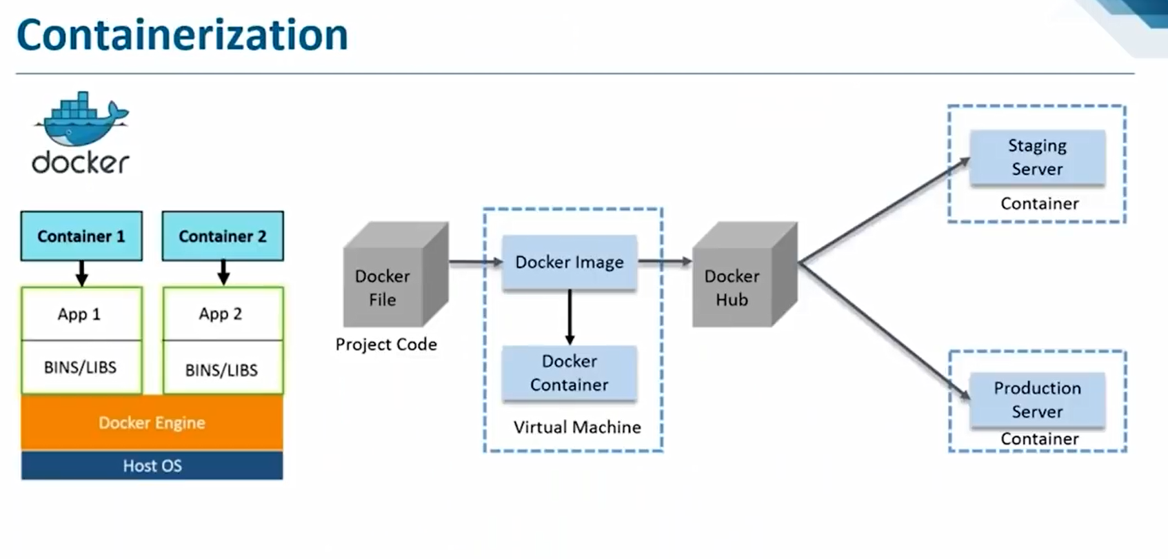

Slide 27
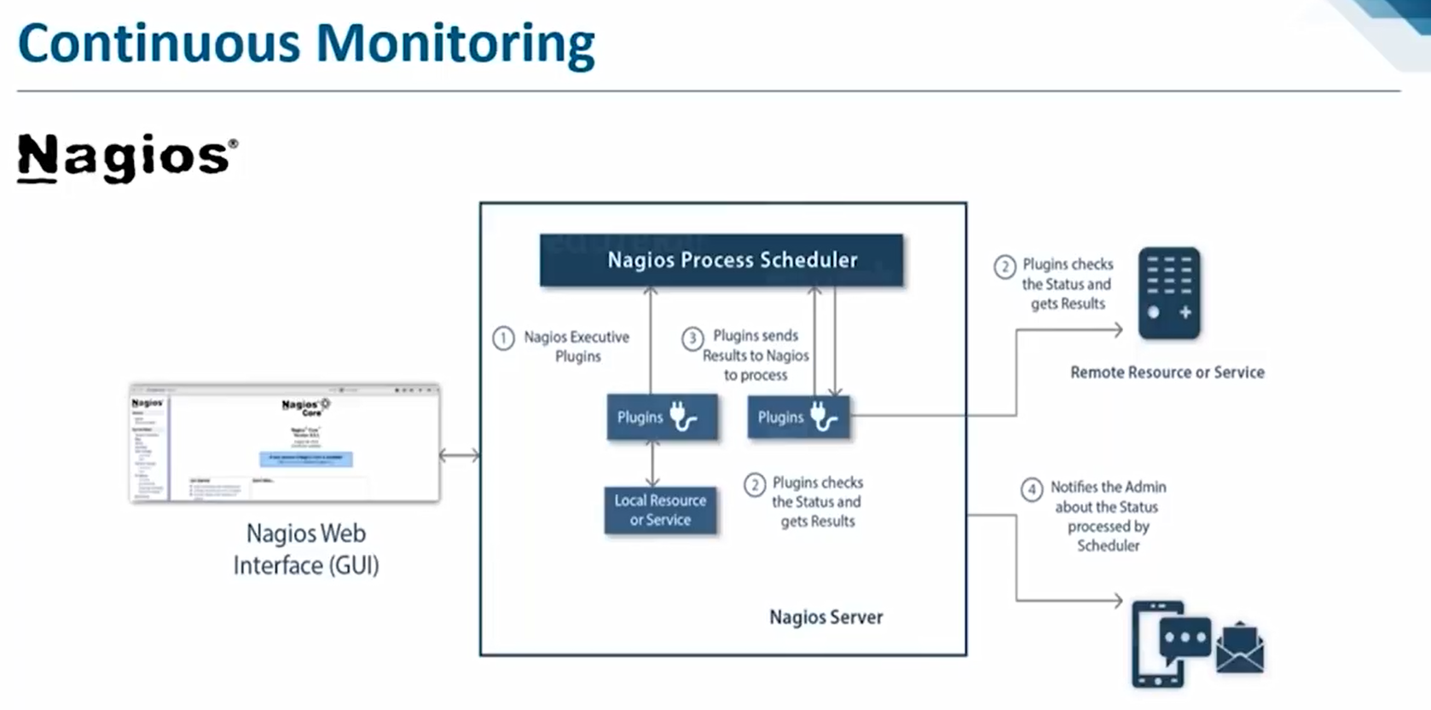

Slide 28
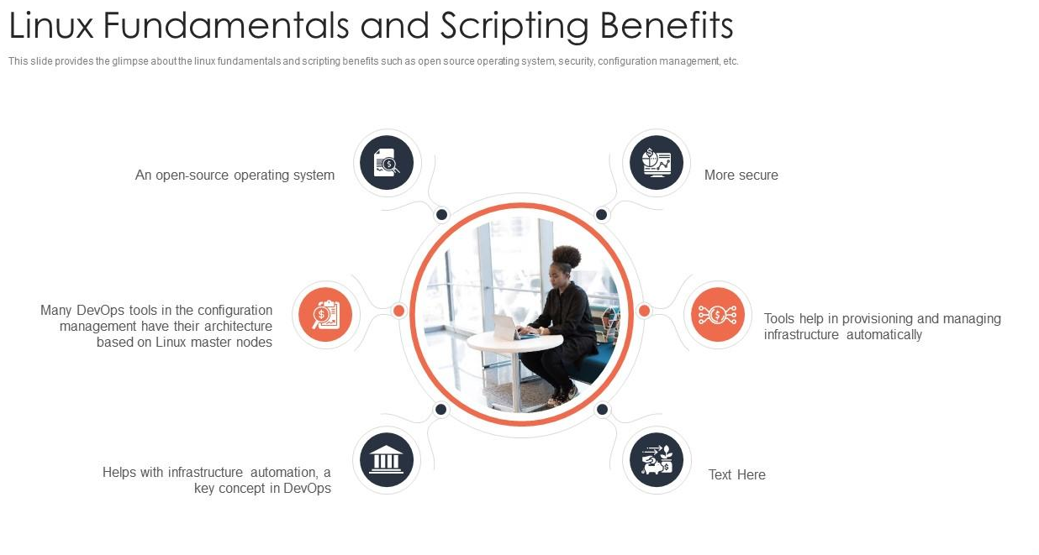

Slide 29
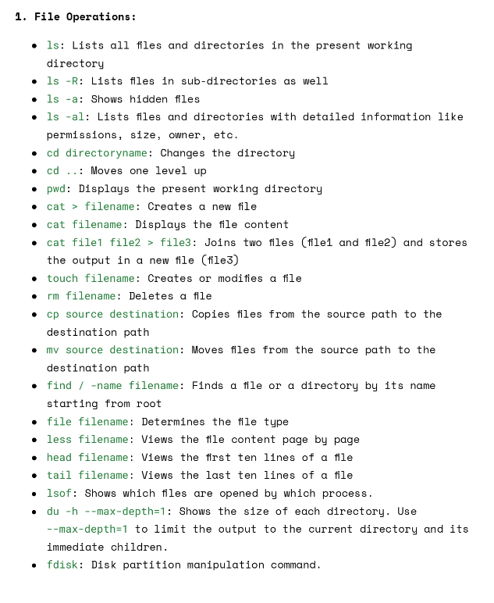

Slide 30
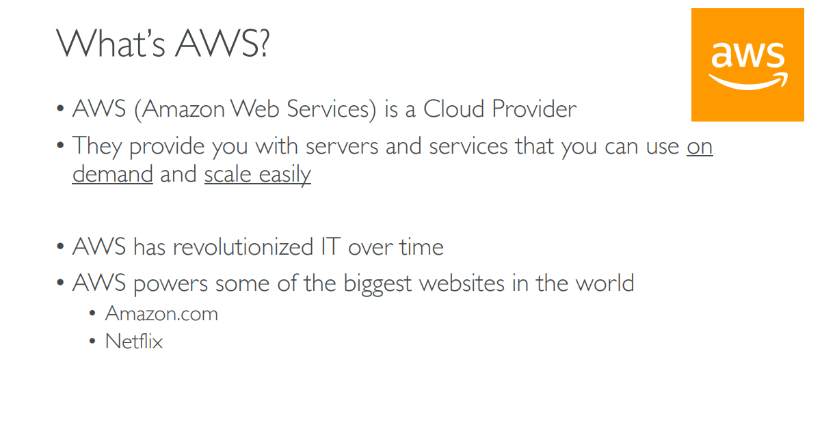

Slide 31


Slide 32


Slide 33


Slide 34


Slide 35


Slide 36


Slide 37


Slide 38





Slide 39


Slide 40


Slide 41


Slide 42


Slide 43


Slide 44


Slide 45


Slide 46


Slide 47


Slide 48


Slide 49


Slide 50


Slide 51


Slide 52


Slide 53


Slide 54


Slide 55


Slide 56


Slide 57


Slide 58


Slide 59


Slide 60

introduction to Ansible

Slide 61


Slide 62


Slide 63


Slide 64


Slide 65


Slide 66


Slide 67


Slide 68


Slide 69


Slide 70


Slide 71


Slide 72


Slide 73


Slide 74


Slide 75


Slide 76


Slide 77


Slide 78


Slide 79


Slide 80

GIT

Slide 81


Slide 82


Slide 83


Slide 84


Slide 85


Slide 86


Slide 87


Slide 88


Slide 89


Slide 90


Slide 91


Slide 92


Slide 93


Slide 94


Slide 95


Slide 96


Slide 97


Slide 98


Slide 99


Slide 100


Slide 101


Slide 102


Slide 103


Slide 104


Slide 105


Slide 106


Slide 107


Slide 108


Slide 109


Slide 110


Slide 111


Slide 112


Slide 113


Slide 114


Slide 115


Slide 116


Slide 117
What is docker file?
A Dockerfile is a simple text file with instructions to build an image. If we do not have the docker file, to build the image and run the container word by word we used the command line interface according to our requirements. But this docker file helps us to provide the instruction on what needs to be pulled, what arguments need to be run after building the image, and providing some configurations.
Why Dockerfile?
Dockerfile is used to create clean images by removing unnecessary content from an image. Used to execute the same steps to create and recreate the images several times.

Slide 118

How Does it Work?

Slide 119

Explaining writing dockerfile

Slide 120


Slide 121
vi Dockerfile
FROM nginx
MAINTAINER Harikrishna
RUN touch test.txt
CMD [“echo” , “my-first-image”]
Build the docker images is :
Docker build –t my-first:latest . (. Means current path)
If it is an another dir we need to specify the path

Slide 122
vi Dockerfile
FROM centos
RUN yum install java -y
RUN mkdir /opt/tomcat/
WORKDIR /opt/tomcat
ADD https://dlcdn.apache.org/tomcat/tomcat-9/v9.0.54/bin/apache-tomcat-9.0.54.tar.gz /opt/tomcat
RUN tar xvfz apache*.tar.gz
RUN mv apache-tomcat-9.0.54/* /opt/tomcat
ADD sample.war /opt/tomcat/webapps/sample.war
EXPOSE 80
CMD ["/opt/tomcat/bin/catalina.sh", "run"]
Docker build –t gol:1.0 .
Dockr run –p 80:80 gol:1.0
http://localhost:8080/sample

Slide 123


Slide 124


Slide 125
Kubernetes Is Easy …..
1.not get started automatically(single host nature of your docker container)
2. auto healing
3. auto scaling (default feature is load balancing)
4. Enterprise --> Docker is simple platform --> it does not support enterprise level (when we deal with big application)
Loadbalancing
firewall
auto scale --> enterprise level standard
healing
API gateways
Who is solving these problems ? kubernetes

Slide 126
Kubernetes solve all the problems
Who is solving these problems ? kubernetes
In general it's a master node architecher --> Cluster is nothing but --> Group of nodes --> masternodes|worker nodes
Faulty node --> immediatly it will create new node/pods
Replication controller(replicat set) --> c1 -->container increasing the traffic
replicaset yaml file / replication controller file --> increase
Heal--> kubernetes controls & fix the damage.

Slide 127
what is meanig of auto healing --> container go down? --> as feture called a auto healing --> it goes down it automatically start the new container
Rollout a new container--> kubernetes rollout a new pod/container going down
kubernetes --> Google --> Borg it is not a open source tool(even a better solutions) --> Enterprise level orchestration platform

Slide 128
























Kubernetes Architecture

Slide 129










































Slide 130



Slide 131














































